Slide 1

Characterization of Thermal Conductivity using Deterministic Phonon Transport in Rattlesnake
Jackson R. Harter
ANS Professional Conference
San Antonio, Texas
June 11 2015

Slide 2
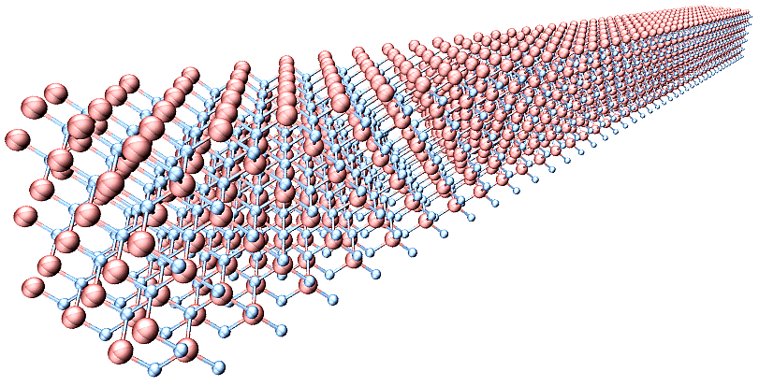
Outline
Background
Goals and Objectives
Methods
Test Problem
Results
Conclusion

Slide 3
Background
Why do we care about phonon transport?
Phonons are dominant mechanism for heat transport in ceramic based materials
We can use information from Boltzmann transport calculations to determine thermal conductivity
Heat flux, temperature gradient
High fidelity simulations with deterministic solver
Very applicable to existing and future nuclear fleet
Real time data for thermal conductivity

Slide 4
Background
Thermal conductivity in nuclear fuel is obtained experimentally
Measurements on microstructure
Analysis of fuel in different stages of burnup yields empirically fit equations (akin to thermal hydraulics correlations…)
An extremely important parameter for safe operation of a nuclear facility
Dependent upon and influenced by many other properties, e.g. fuel and moderator temperature, isotopic concentrations

Slide 5
Goals and Objectives
Create a module within MOOSE which uses Rattlesnake to model 3D phonon transport
First principles, physics-based calculation
Bridge the gap between molecular dynamics and engineering scale simulations
Characterize bulk, heterogeneous nuclear fuels with fission product defects
UO₂, PuO₂
Phonon intensity, heat flux, temperature, thermal conductivity
Adviser: Dr. Todd Palmer

Slide 6
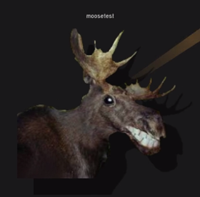
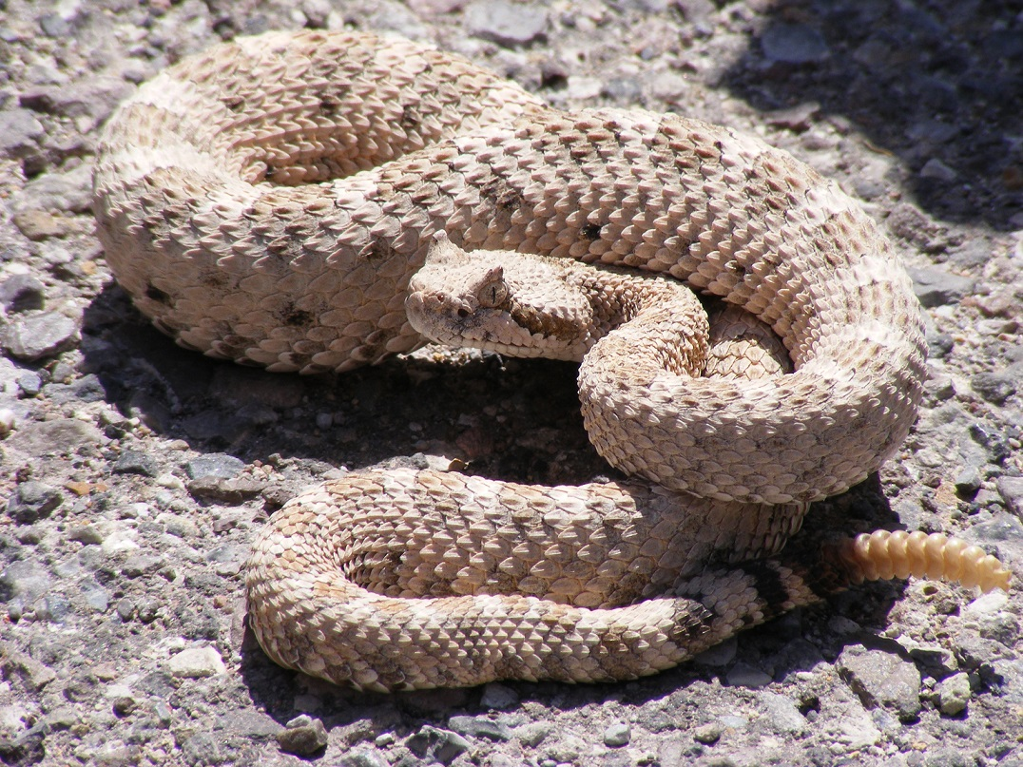
Methods
What is MOOSE?
Multi-physics Object Oriented Simulation Environment
Sophisticated framework for solving coupled PDEs
Massively parallelizable
Finite element mesh discretization
What is Rattlesnake?
Solves the Boltzmann transport equation (BTE) for neutrons using the Self-Adjoint Angular Flux (SAAF) formulation
S_{N} and P_{N} angular discretization, acceleration

Slide 7
Methods
Solve the BTE for phonons
Similar physics to radiative heat transfer
Phonon mean free path
Relaxation time and group velocity
Substituted for macroscopic interaction cross section
Scattering kernel involves equilibrium phonon distribution [Bose-Einstein, f₀(ω,T)]
Deterministic numerical approach
S_{N} angular discretization
Finite element spatial discretization
Potential for multigroup treatment of phonon frequency

Slide 8
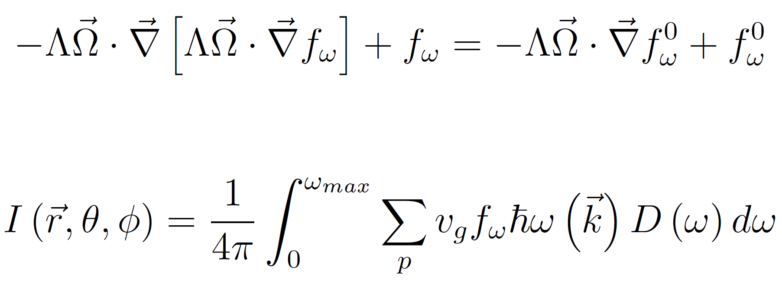
Methods
Self-Adjoint Angular Flux formulation of BTE for phonons
Yields frequency independent, gray medium Equation of Phonon Radiative Transport

Slide 9
Test Problem
Developed 1D code in Matlab
1D, slab geometry, gray (frequency independent)
SAAF transport with finite difference discretization of Morel and McGhee
Source iteration (no acceleration for iteration on “scattering source”)
Test problem: Si thin film calculation of temperature, heat flux, and thermal conductivity
Yilbas and Bin Mansoor (2012)
Si film
3 mean free paths thick, highly scattering
K = 157 [W·m⁻¹·K⁻¹]
C_{v} = 1.65·10⁶ [J·m⁻³·K⁻¹]
v_{g} = 8430 [m·s⁻¹]
T_{L} = 301 [K], T_{R} = 300 [K]
Λ = 33.8·10⁻⁹ [m]

Slide 10
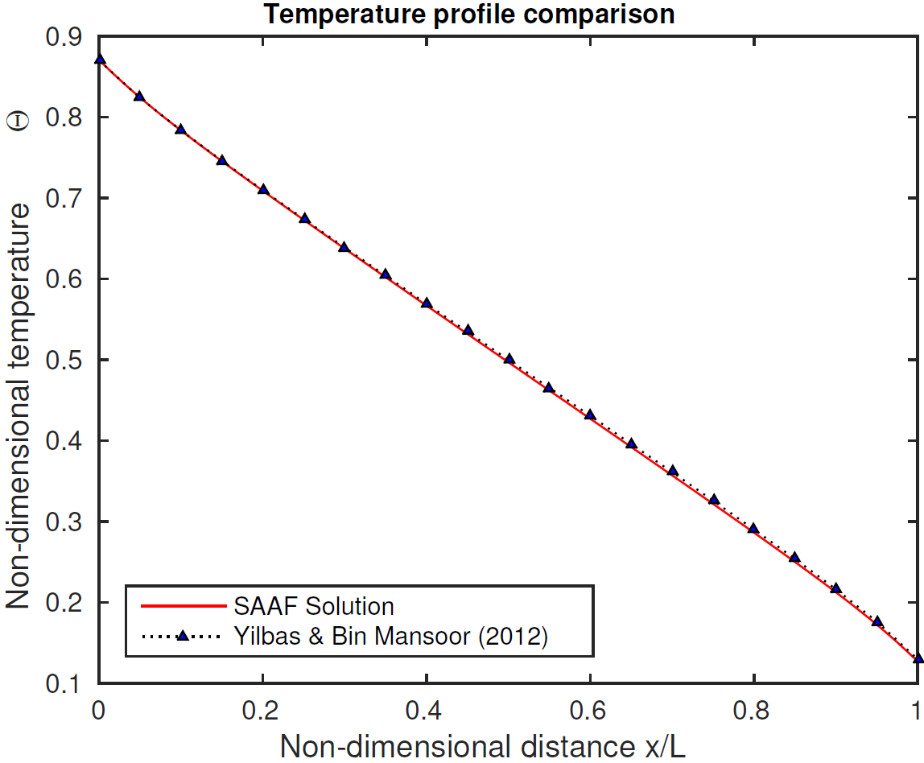
Test Problem

Slide 11
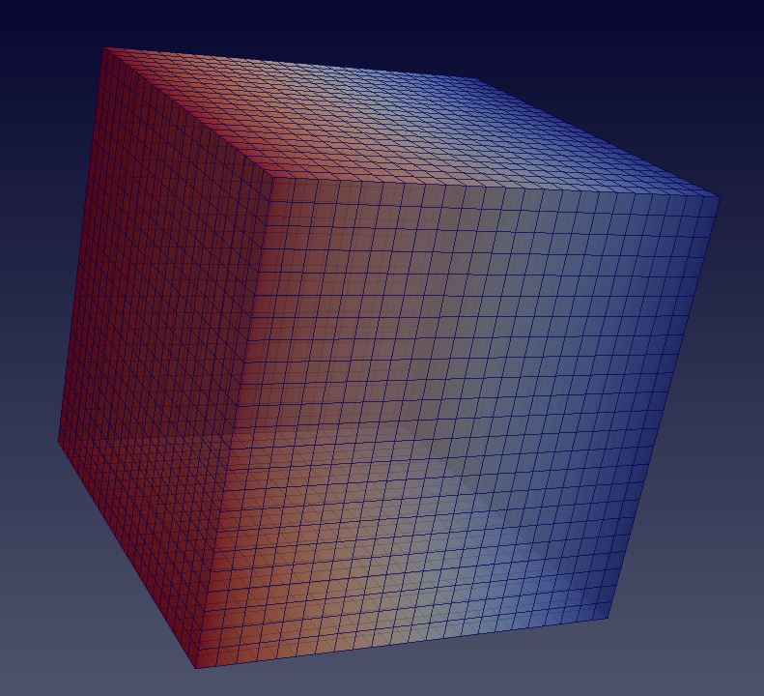
Results
Rattlesnake results also reproduce those of Yilbas and Bin Mansoor
Isotropic scattering conditions; phonon sources in YZ planes – other boundaries reflective
Quadrature S_{N} = 8
Mesh generated with Cubit
MOOSE uses PETSc - sparse linear solver with preconditioning

Slide 12
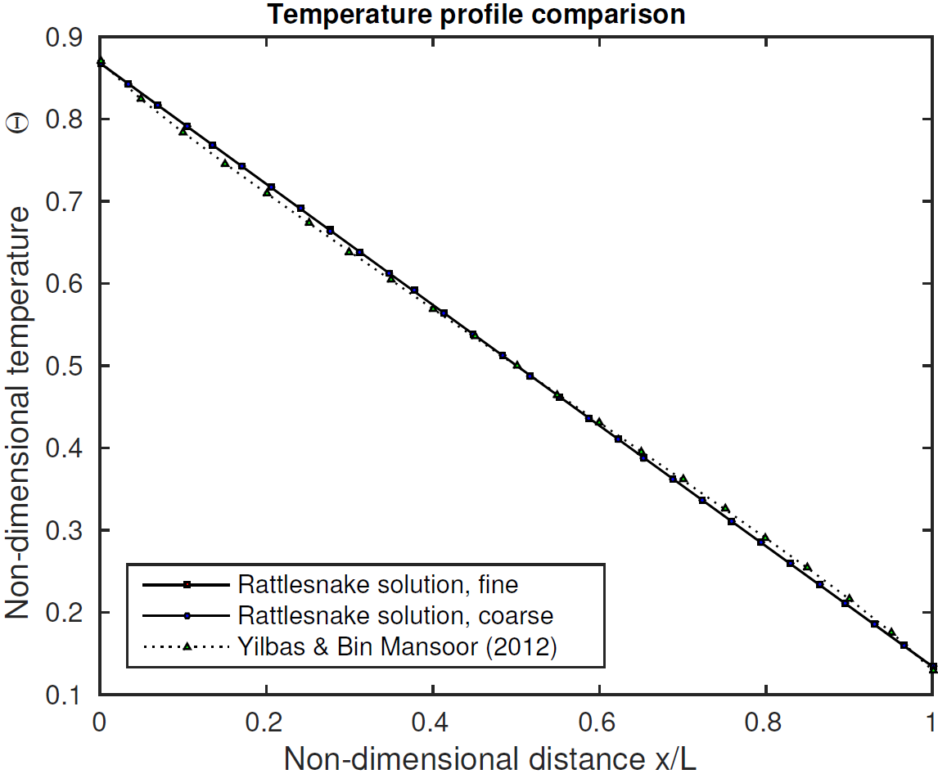
Results

Slide 13
Results
Rattlesnake is able to capture 1D phonon transport physics effectively
Scale of test problem involves phonon scattering in diffuse regime
Boundary scattering dominates
Highly diffuse, minimally ballistic
Coarse and fine mesh yield similar results
Temperature distribution highly linear; good agreement with other phonon transport literature

Slide 14
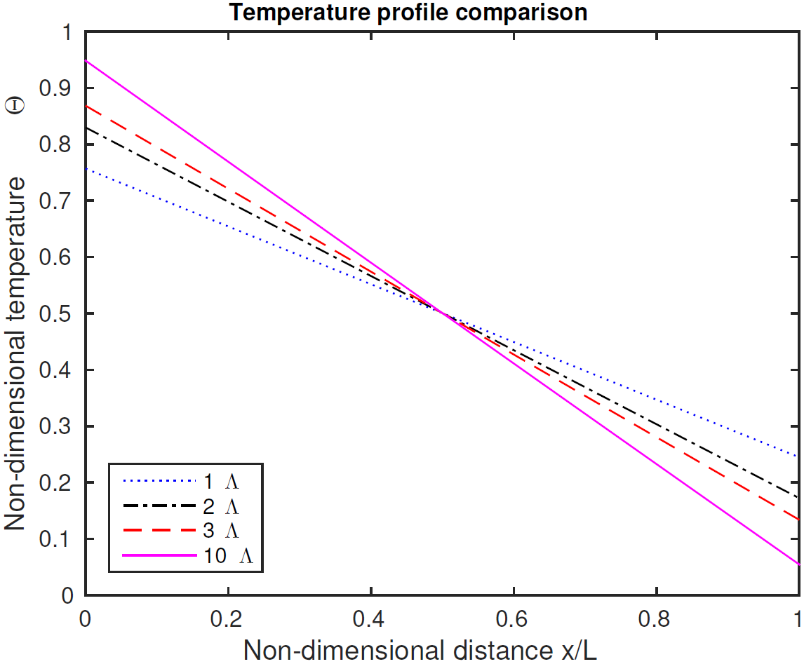
Boundary Scattering Effects

Slide 15
2D Heterogeneous System
2D simulation of heterogeneous material
Aluminum and silicon
Large difference in length scales and MFPs
3.4 x 3.4 nm square aluminum
250 x 250 nm square silicon
Λ_{Si} = 33.8·10⁻⁹ [m]
Λ_{Al} = 2.9·10⁻⁹ [m]
Aluminum dot at 301K, emissive source
Silicon boundaries at 300K

Slide 16
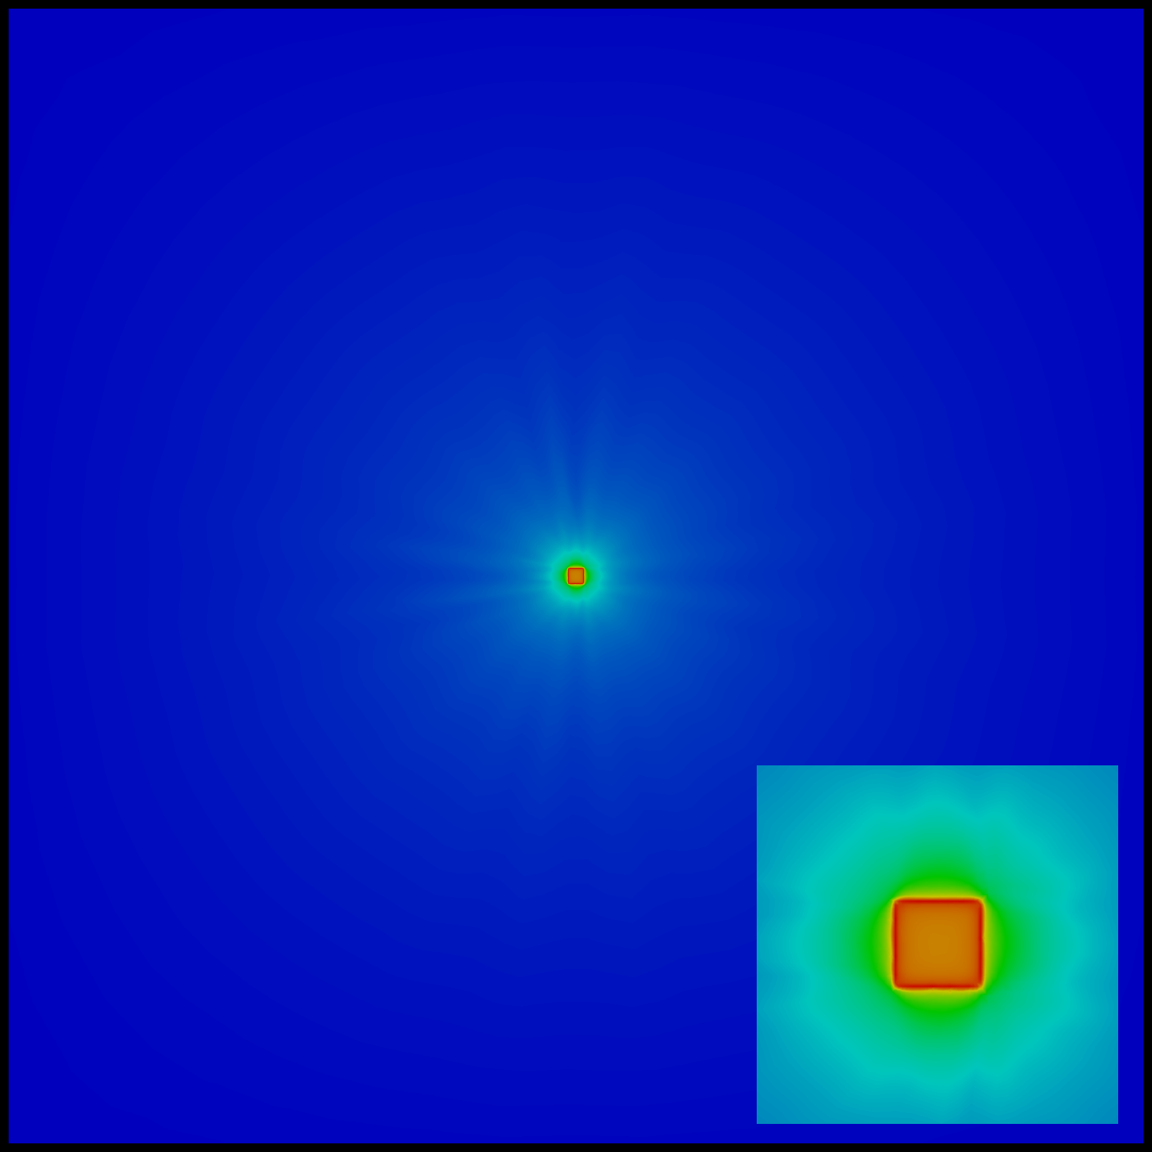
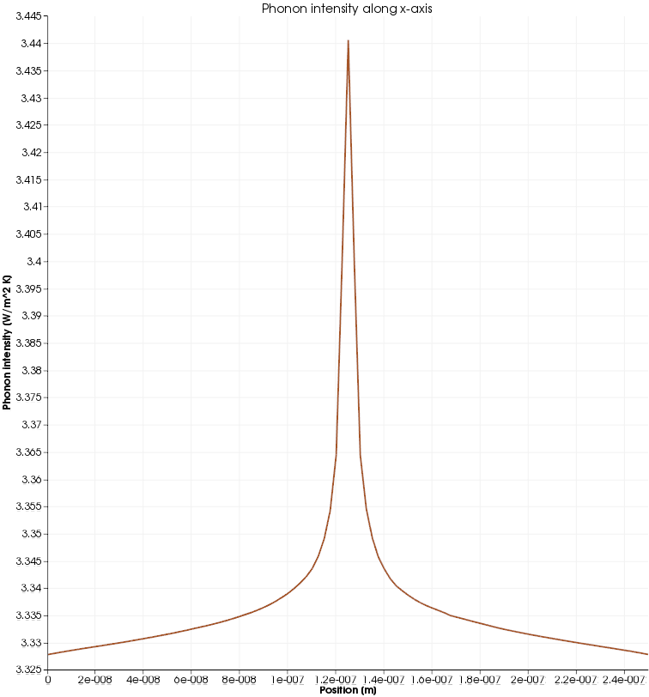
Results
Al/Si Transient Simulation

Slide 17
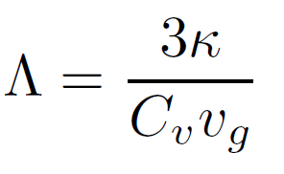
κ in UO₂ single crystal
Rattlesnake simulation in comparison against experimental data in Gofryk et al.
Depleted UO2 single crystals
Measurements taken with Physical Property Measurement System-9, 9 T superconducting magnet
Two and four terminal probe leads – gold plated copper, connected with silver epoxy
Sample size - 1 x 1 x 7 mm bar, annealed in Ar-6%H₂ at 850˚C
Simulation run in supercell geometry ~10mfp
MFP obtained through thermal conductivity relationship
Used κ from experimental data
Equilibrium κ within 0.05%

Slide 18
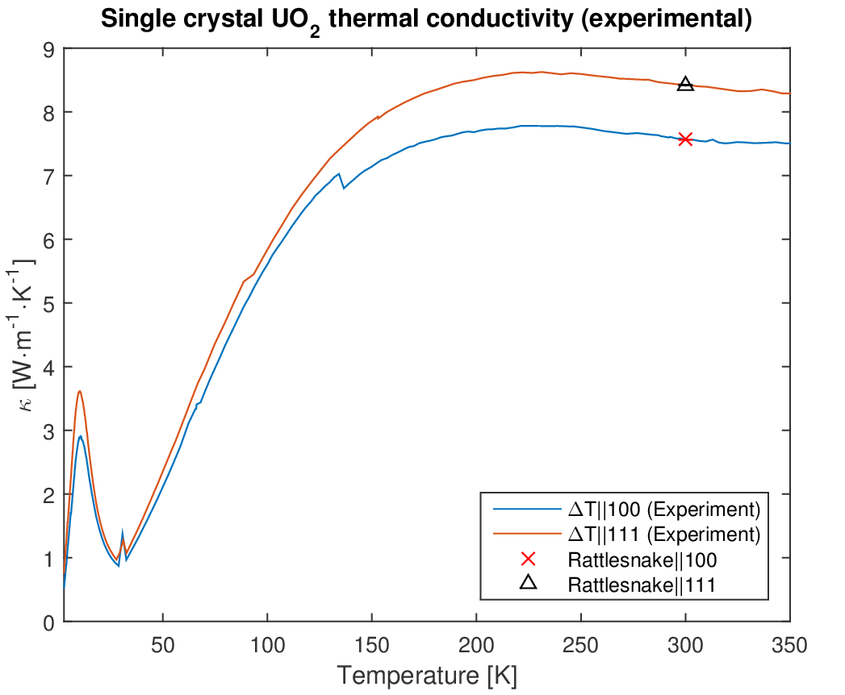

Slide 19
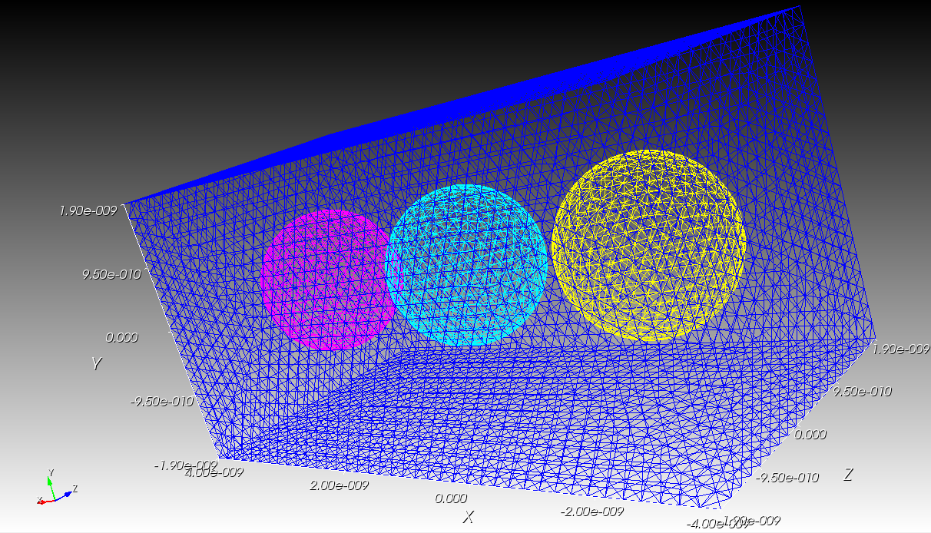
Conclusion
Rattlesnake can be used to simulate phonon transport
Goal is prediction of thermal conductivity in bulk heterogeneous nuclear fuels with fission product defects
Currently building a UO₂ matrix with Xe bubbles to simulate defect scattering

Slide 20
Future Work
Model a “real” material (UO₂ with Xe defects)
Continuation into PhD
Construct non-export controlled phonon transport module
Incorporate frequency dependence
Will allow greater flexibility
Couple with MARMOT, possibly LAMMPS (external to MOOSE family)

Slide 21
Acknowledgements
Dr. Alex Greaney, Oregon State University
Dr. David Andersson, Los Alamos National Laboratory
This study is supported under a Department of Energy grant in conjunction with the Idaho National Laboratory and National University Consortium
Contact: harterj@onid.oregonstate.edu

